Slide 1
AUTOMATION USING SELINIUM AND DOCKER PROJECT
Name: Sravani Manne
Emp id: 201350
E-mail: Sravani.manne@amdocs.com

Slide 2
CONTENTS:
Selenium
Spring boot
Docker

Slide 3
INTRODUCTION:
SELENIUM:
Selenium is one of the most widely used opensource Web UI automation testing suite.
It supports automation across different browsers, platforms and programming languages.
It supports a variety of programming languages through the use of drivers specific to each language.

Slide 4
DOCKER:
Docker is an open platform for developing, shipping, and running applications.
It enables us to separate our applications from the infrastructure so one can deliver software quickly.
Using docker one can manage infrastructure as well as applications.
By taking advantage of Docker's methodologies for shipping, testing, and deploying code, one can significantly reduce the delay between writing code and running it in production.

Slide 5
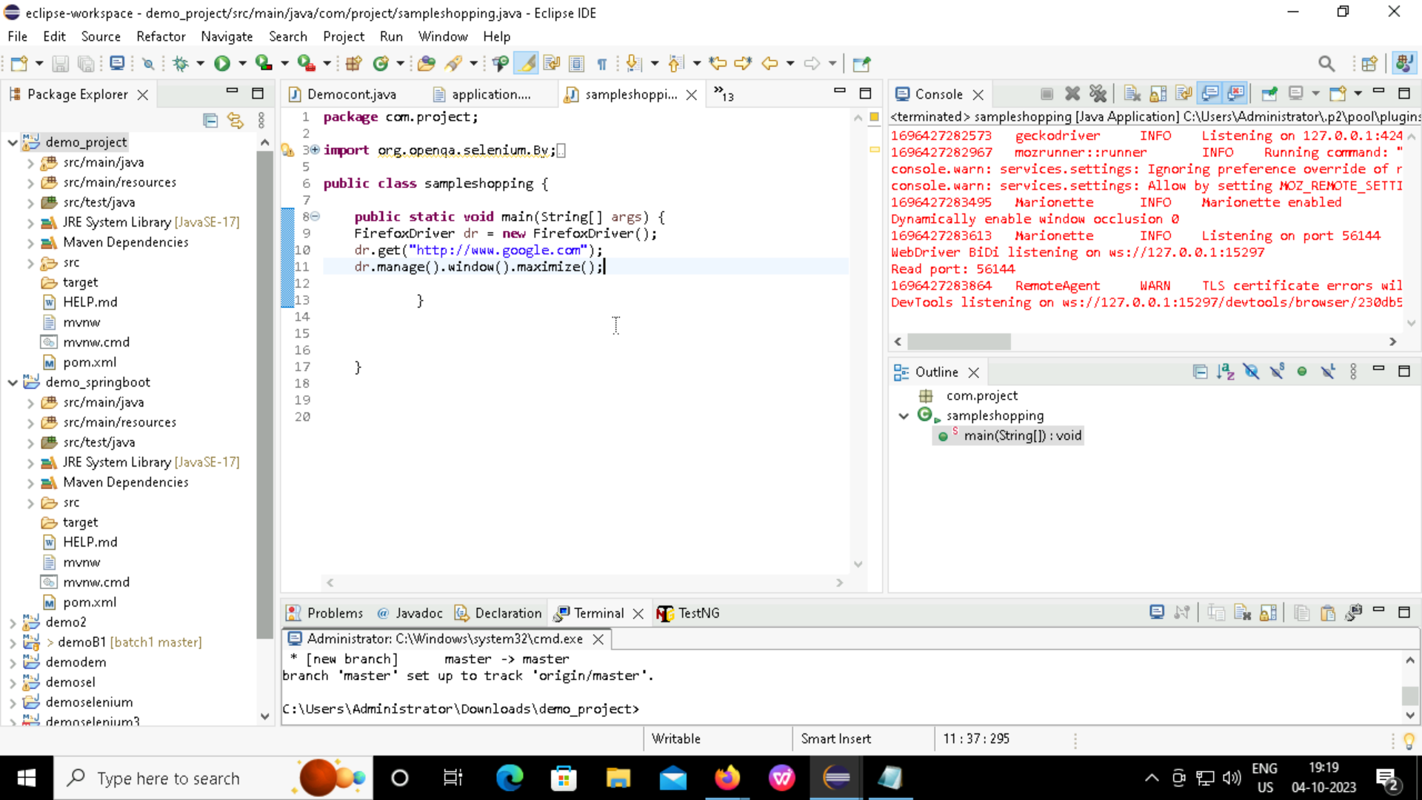
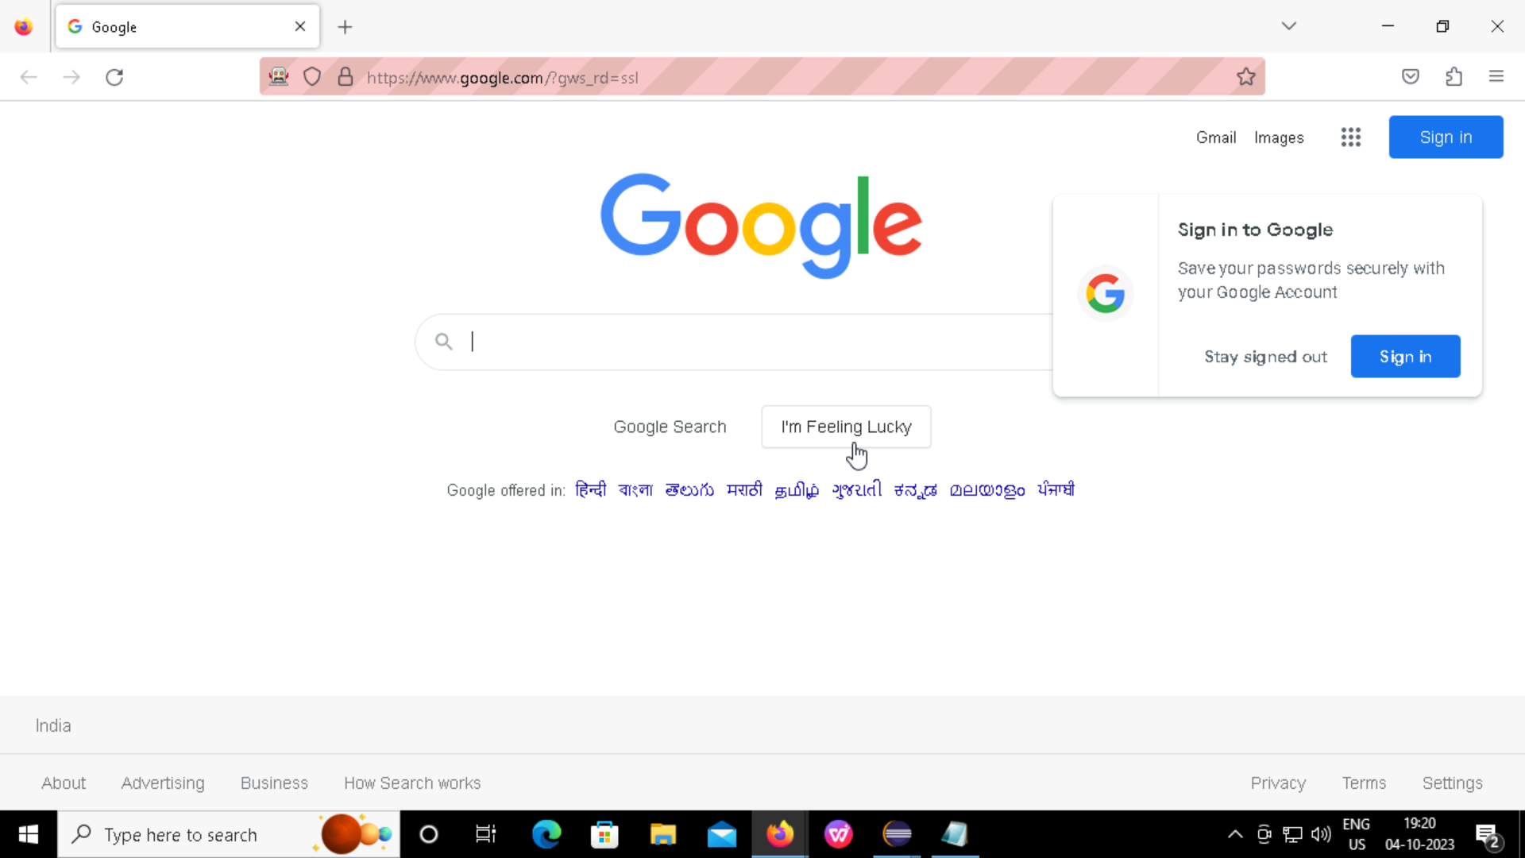
AUTOMATING USING SELENIUM:
Creating simple web driver and importing required libraries.

Slide 6

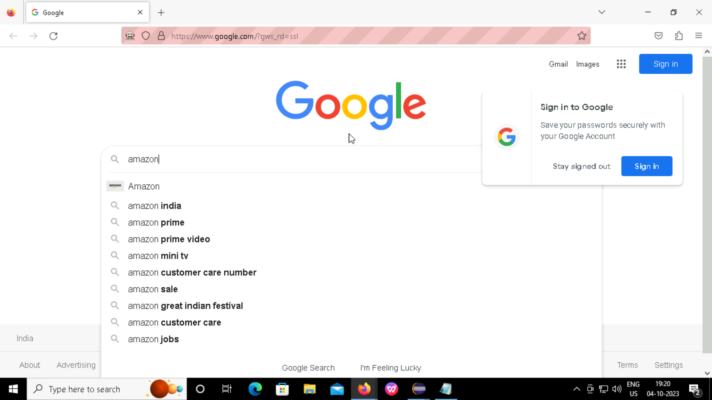
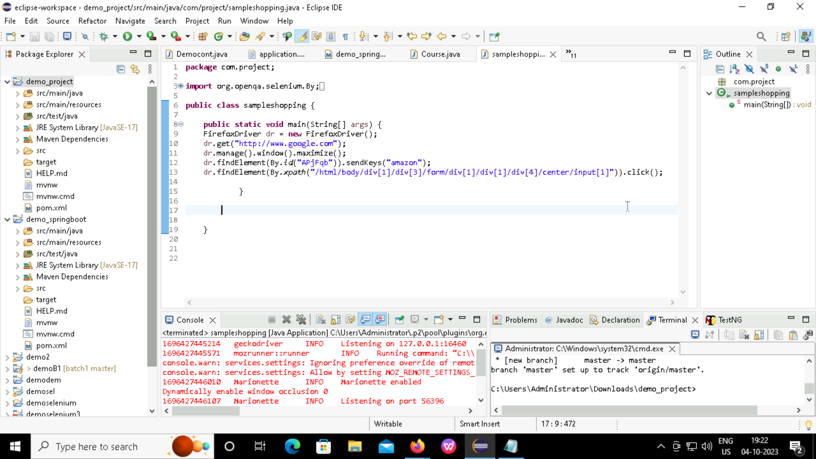
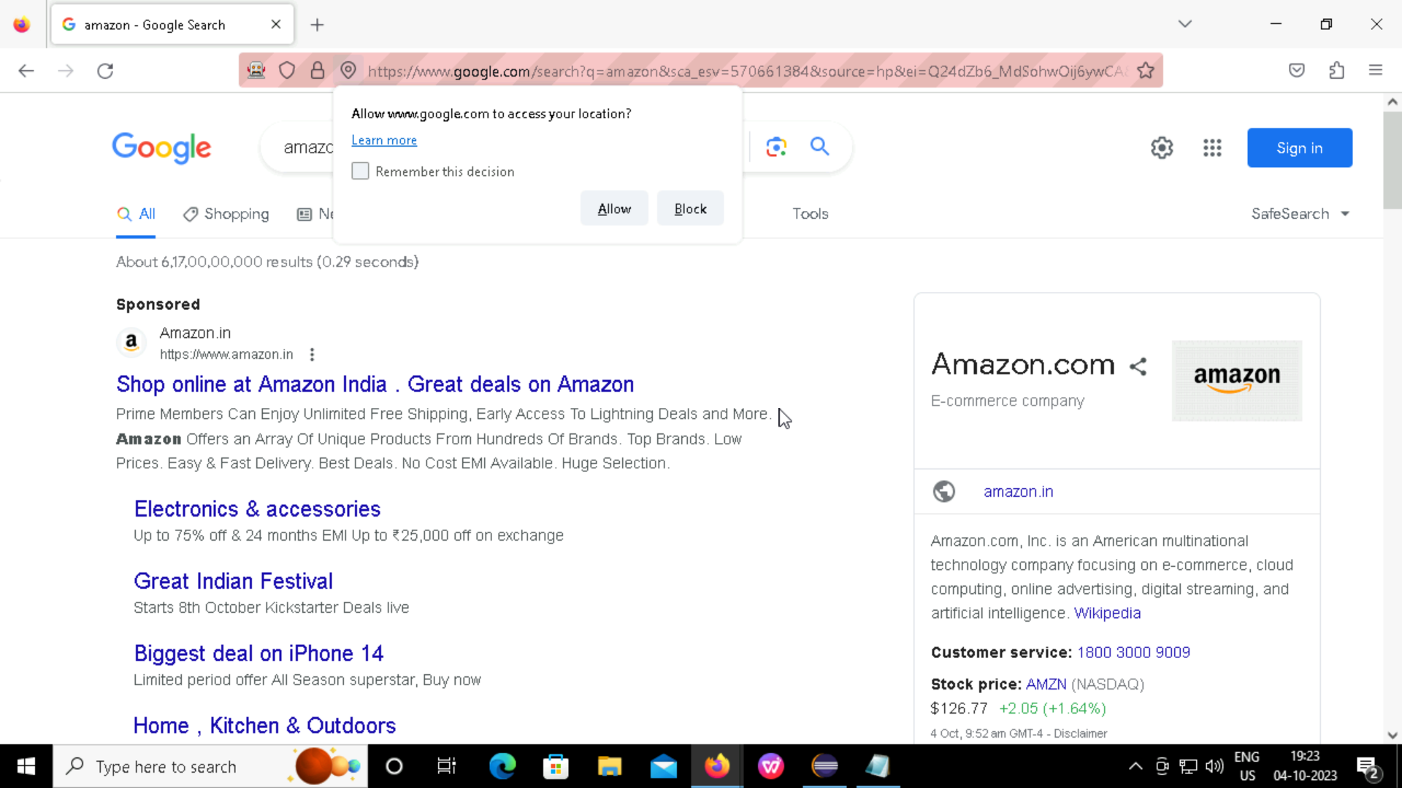
Automating website “amazon”.

Slide 7
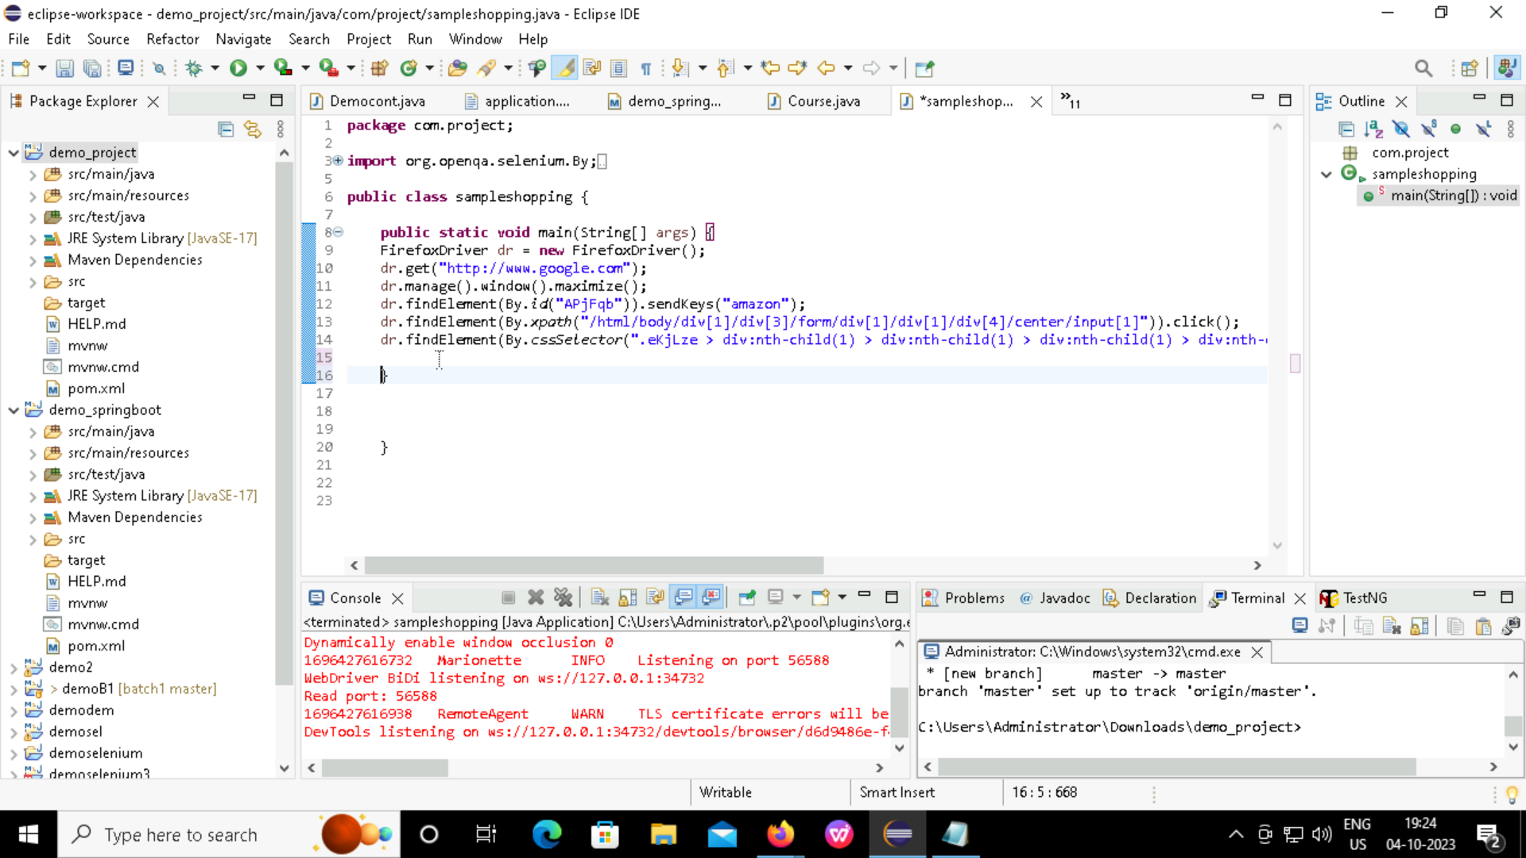
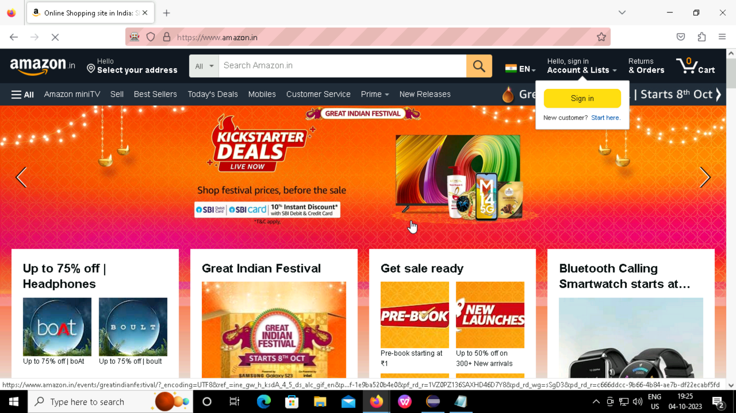
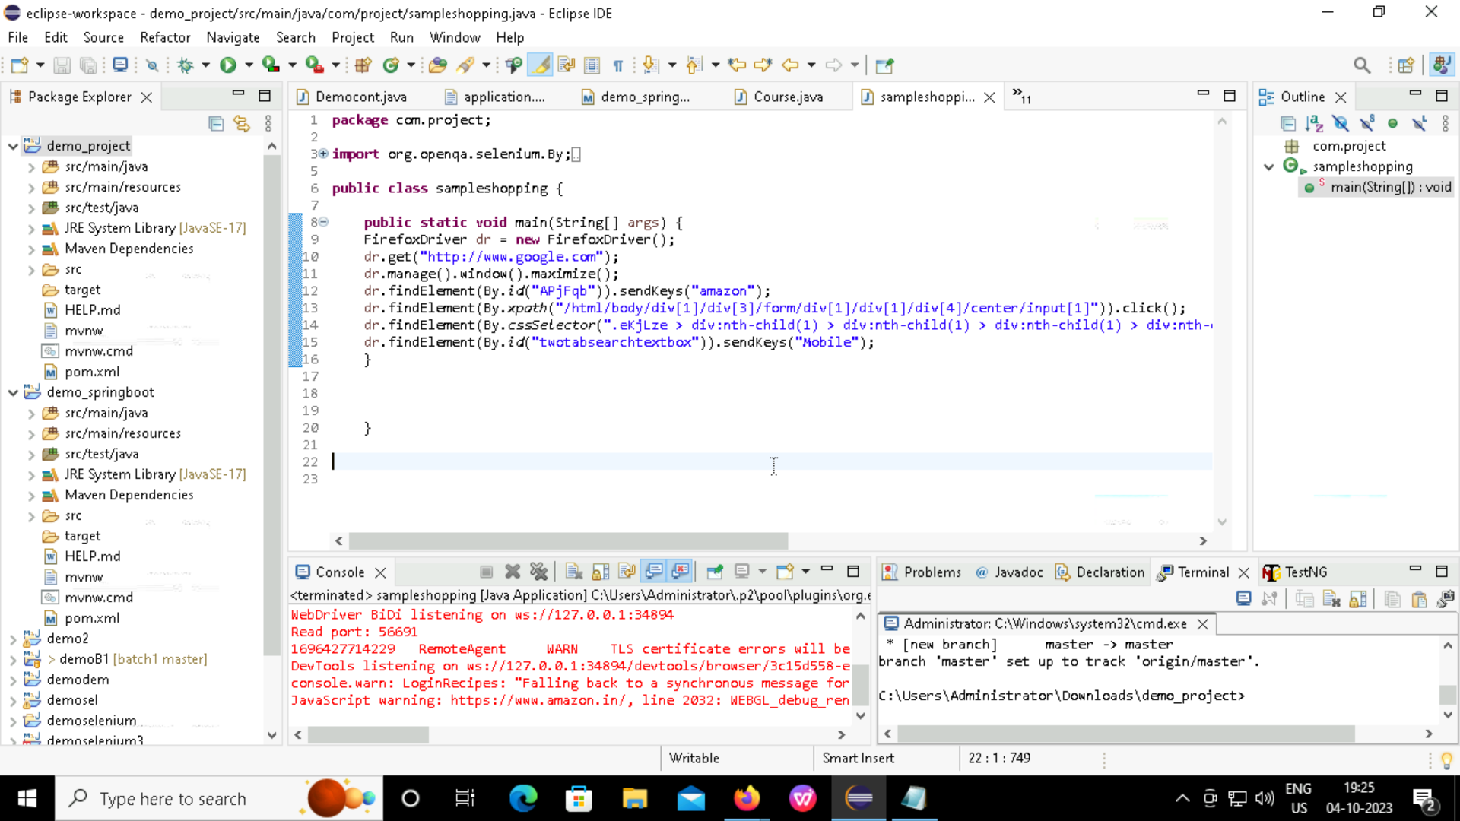
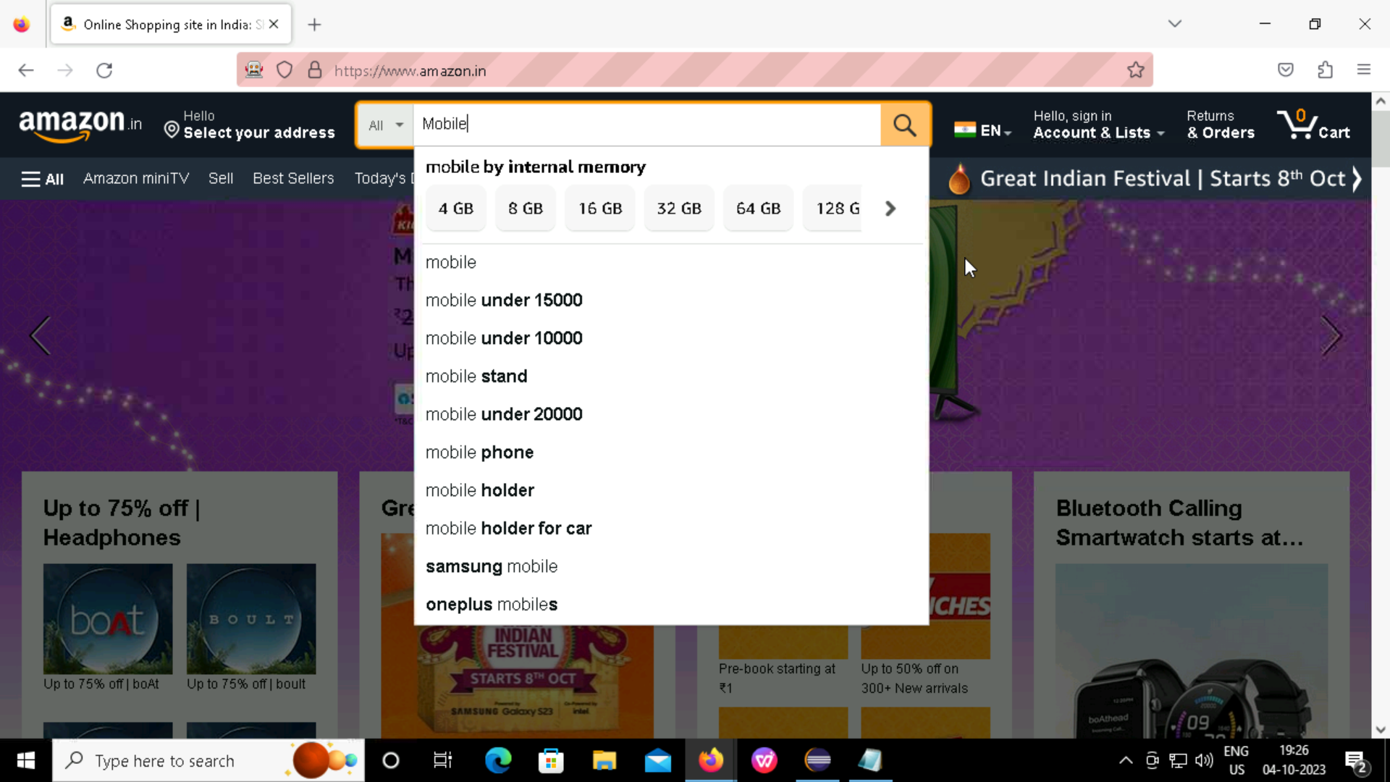
Next searching for the product “Mobile”.

Slide 8
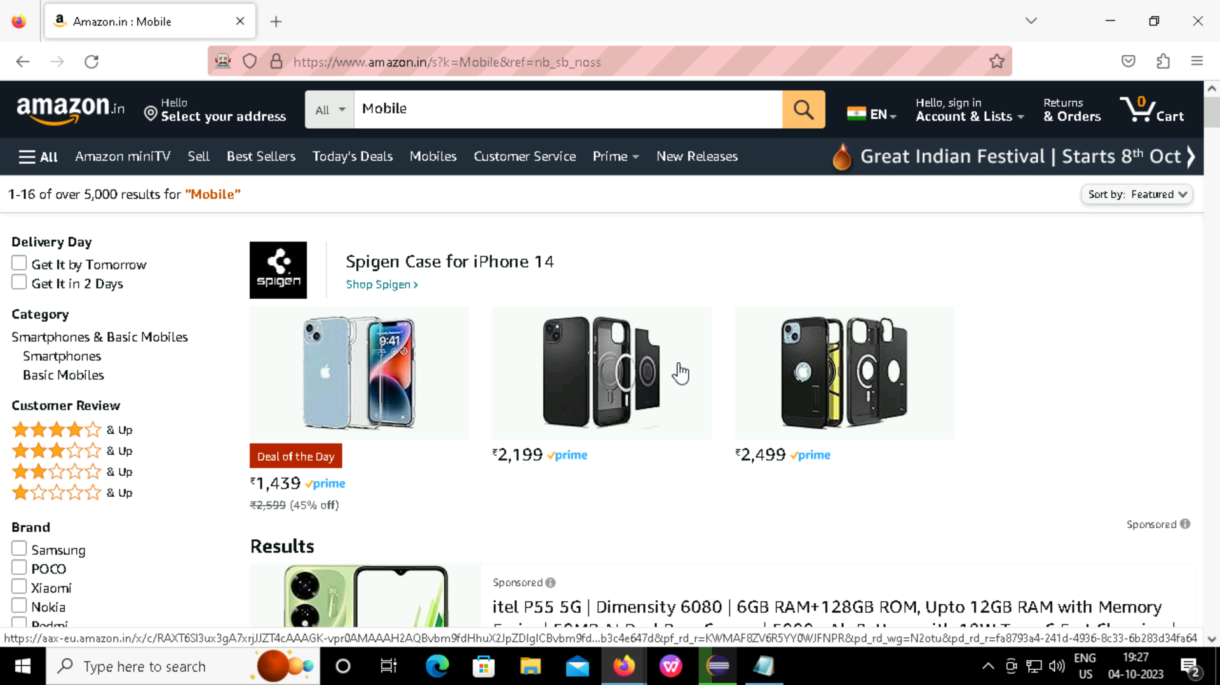


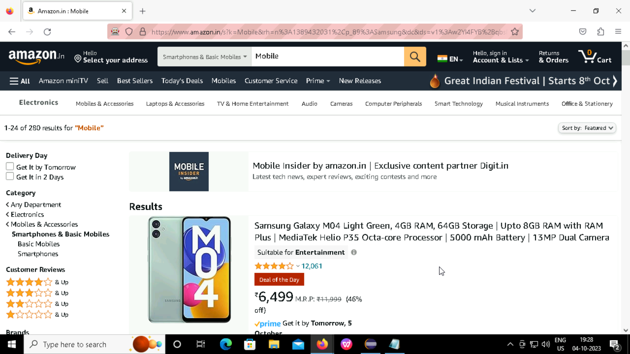
Search for mobile and mobile brand.

Slide 9

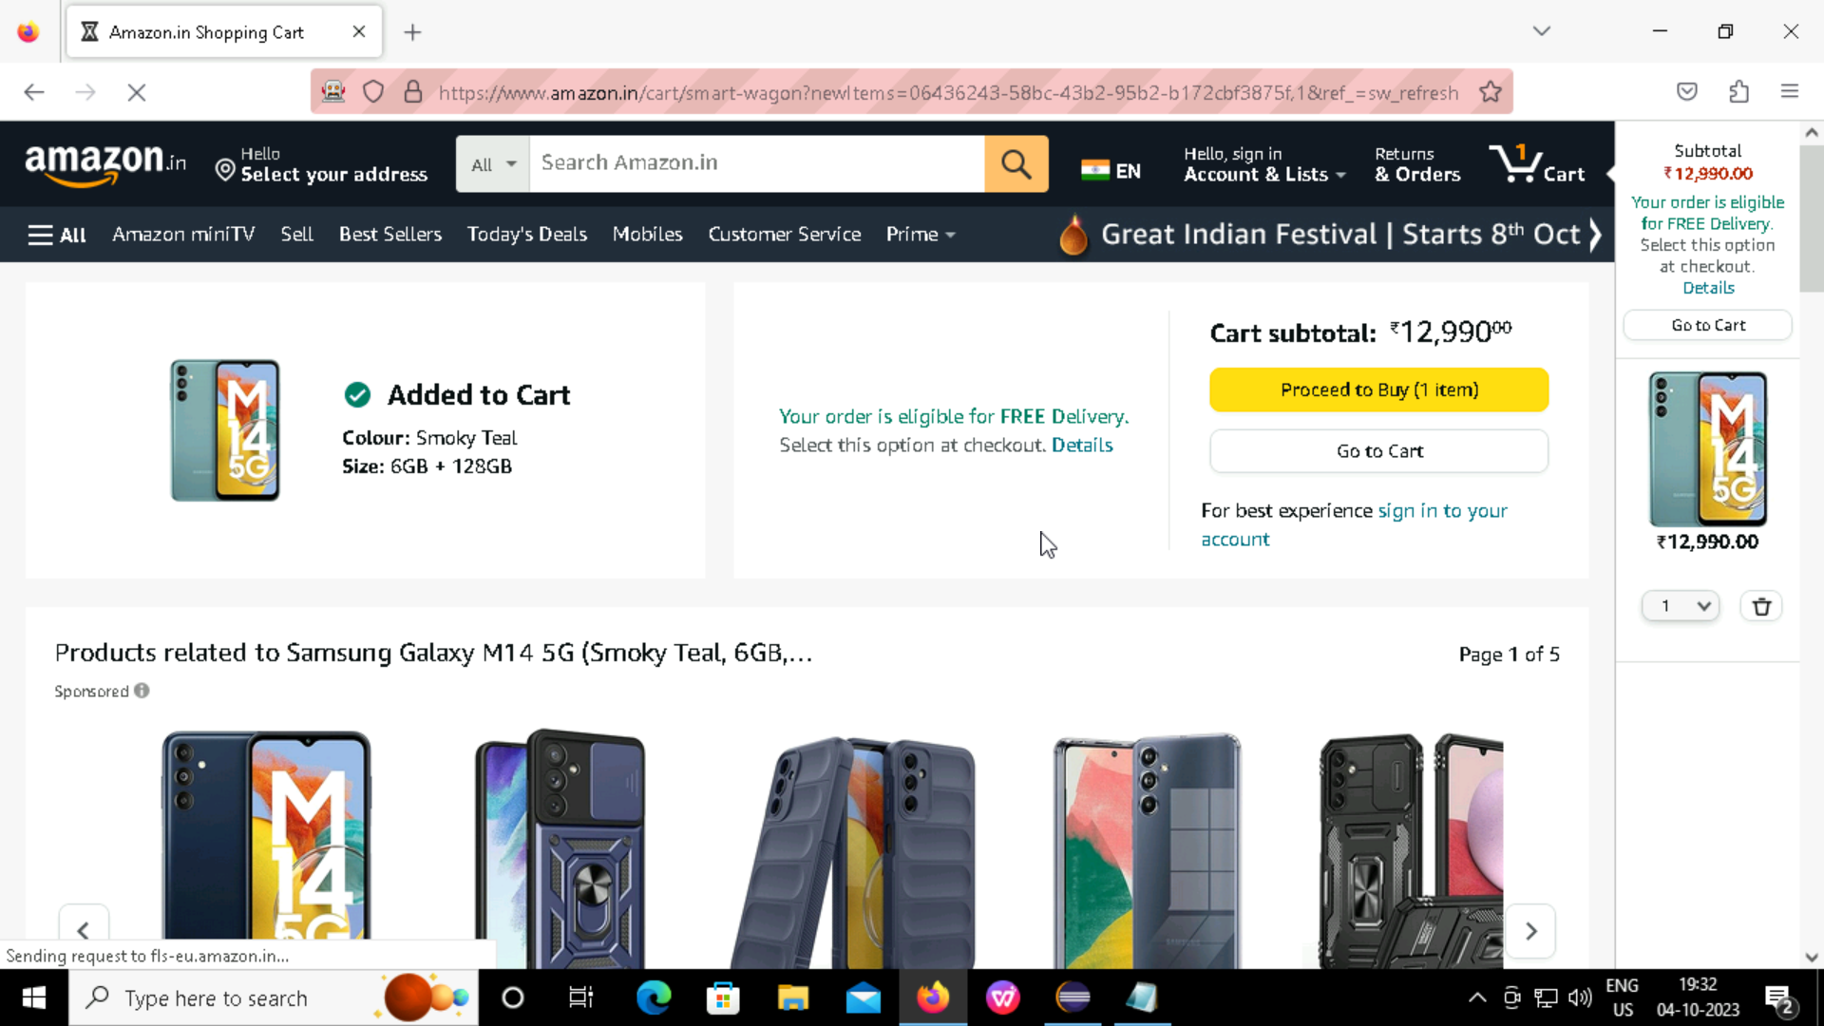
Selecting the mobile and adding it to the cart.

Slide 10
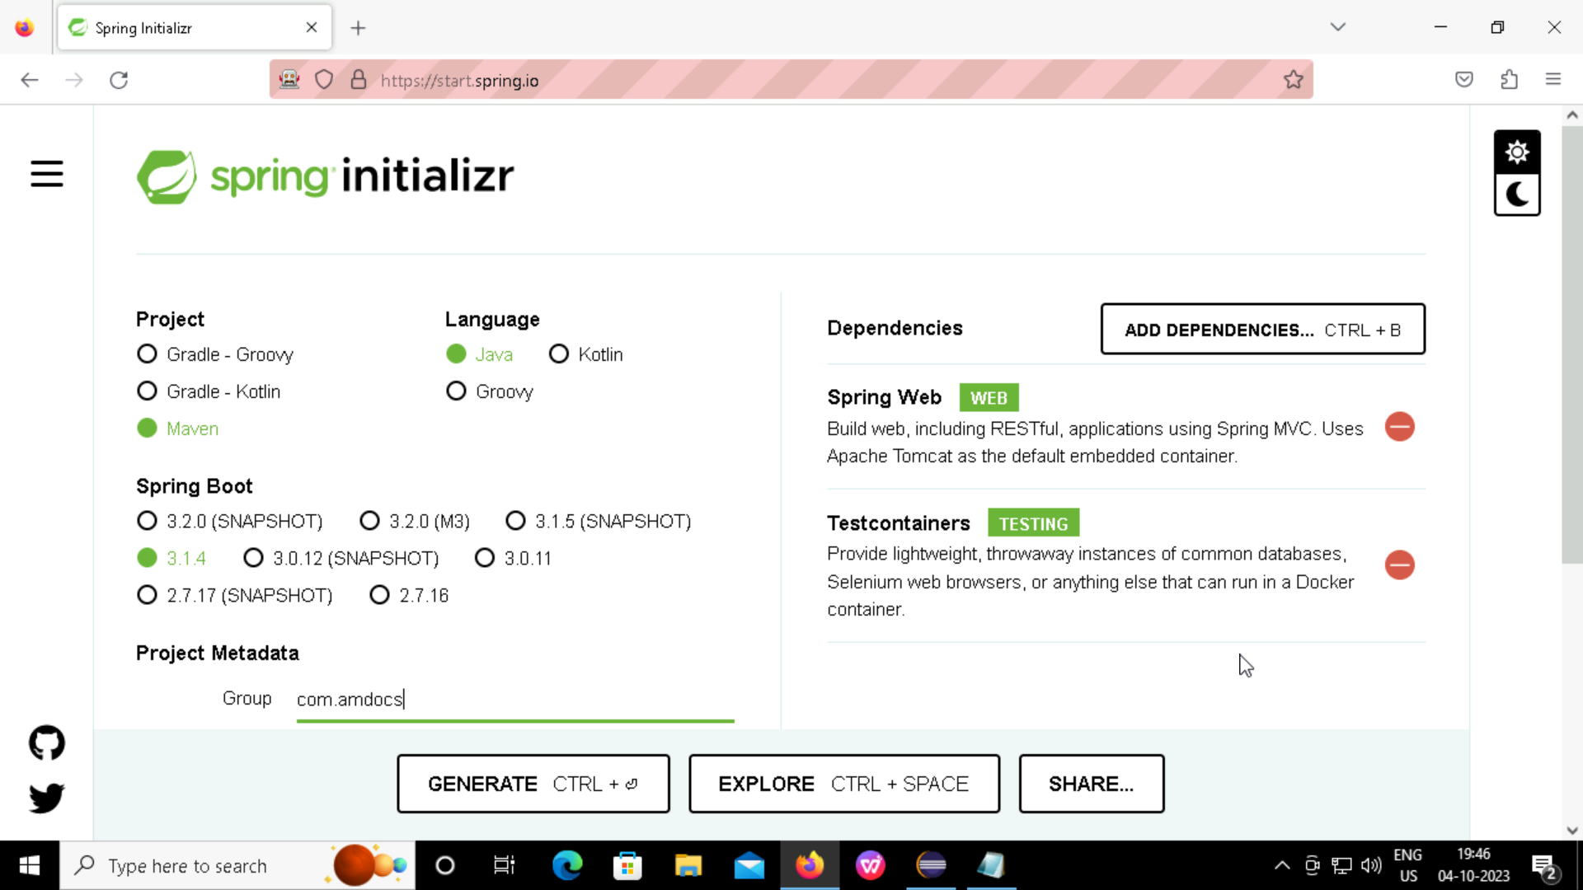
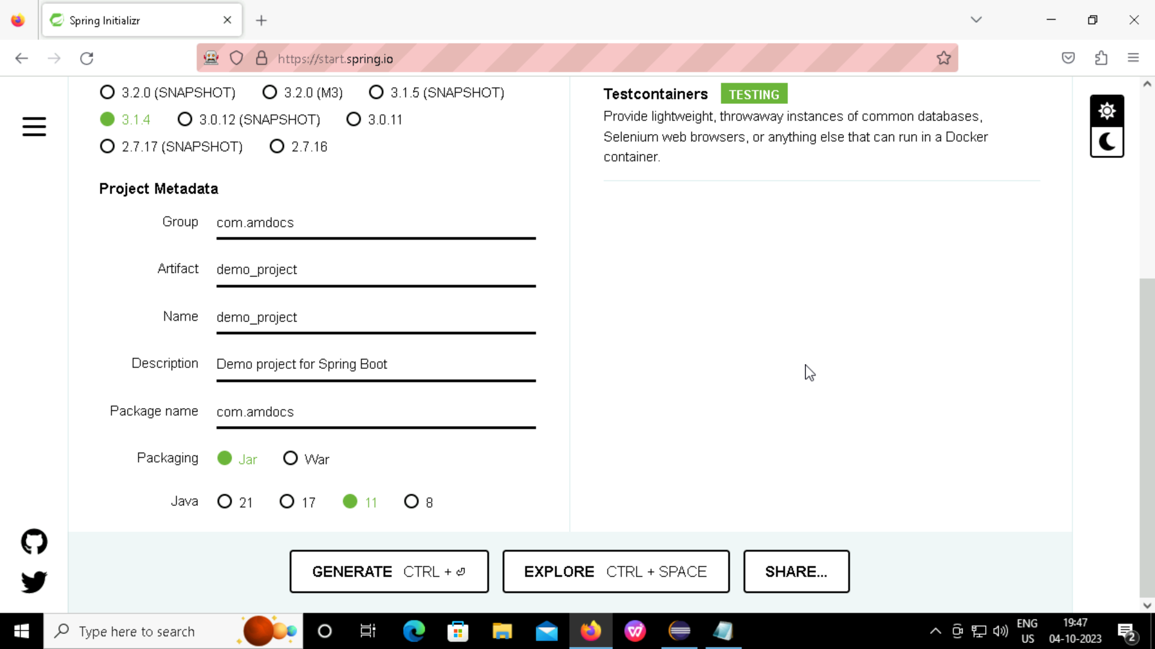
Spring Boot Initializer:

Slide 11
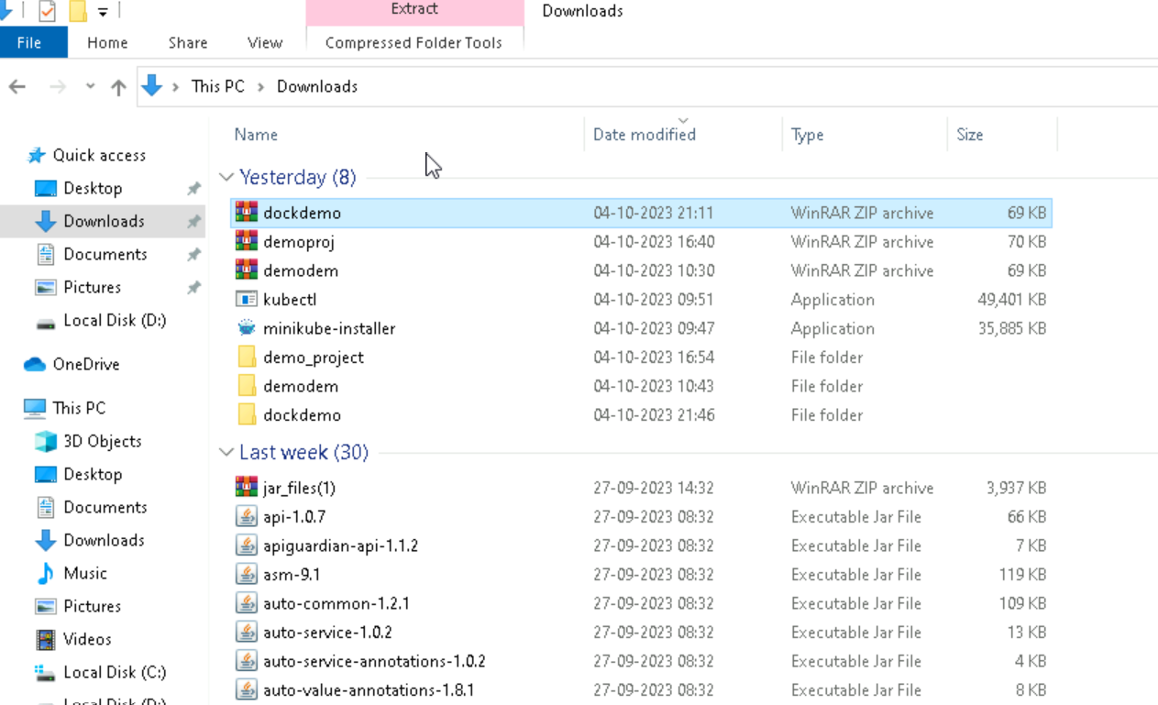
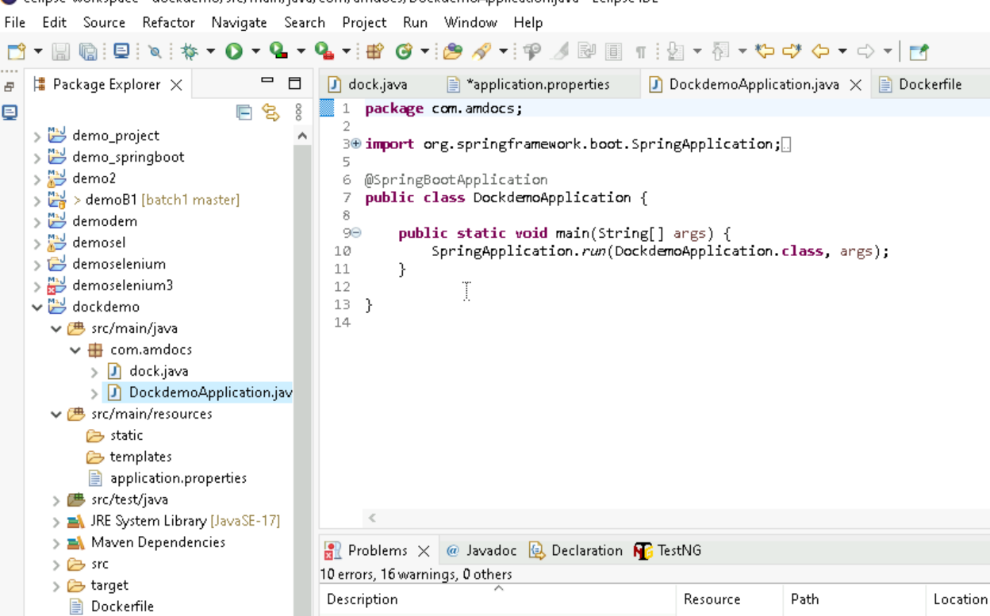
Extracting the zip folder and importing it into eclipse:

Slide 12
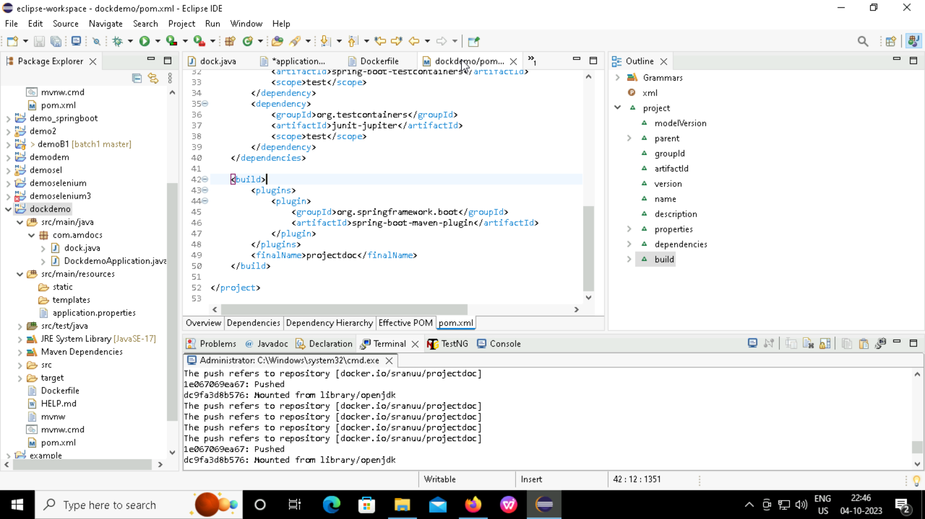
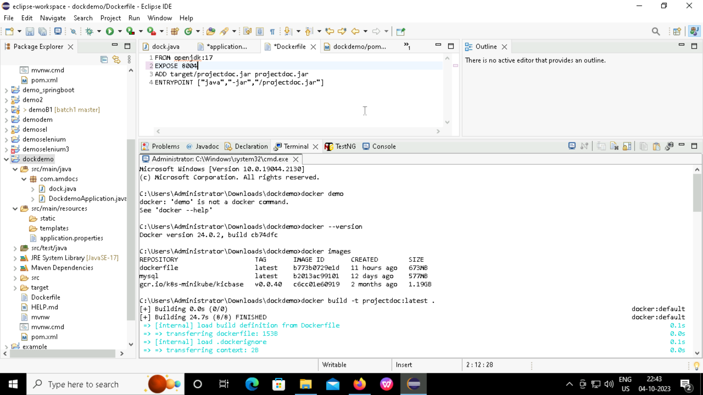
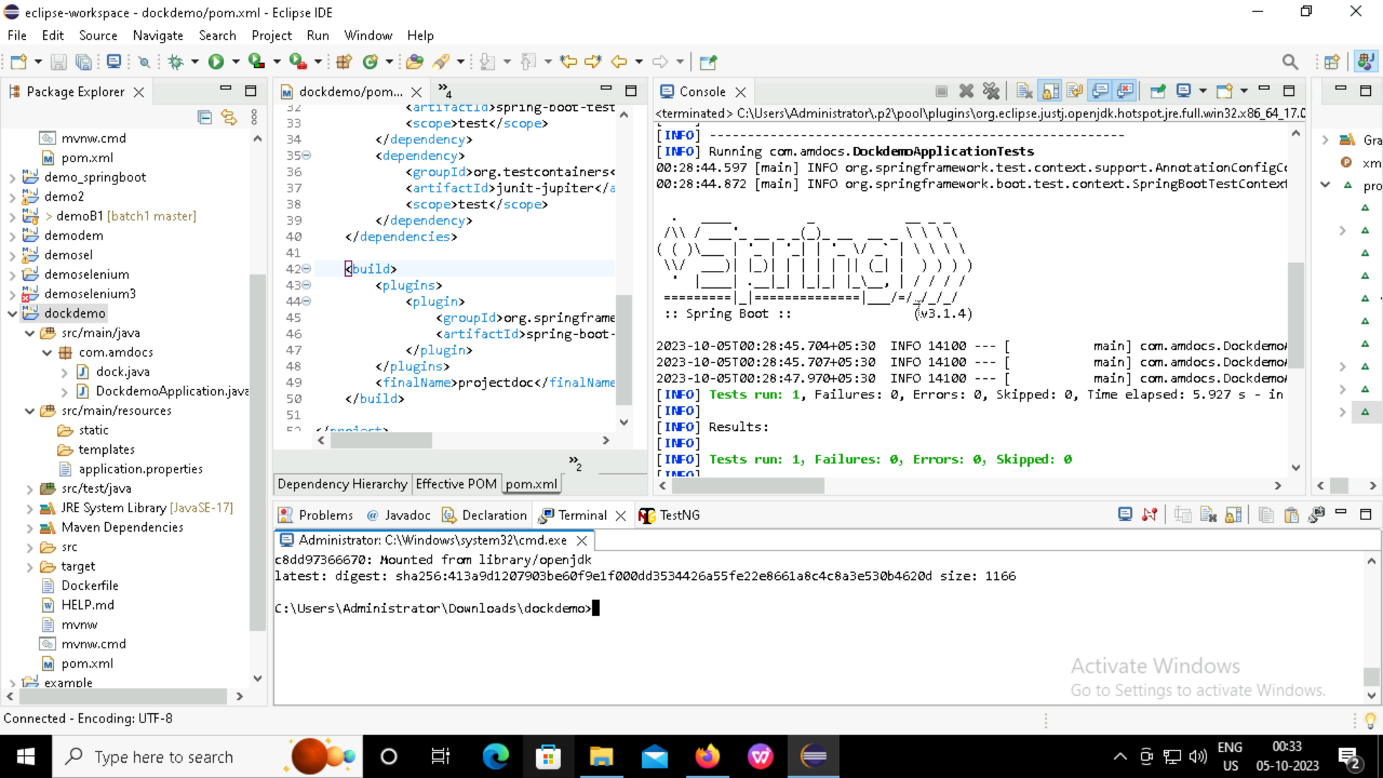
DOCKER:
Creating docker file writing the code, adding filename and running as maven install.

Slide 13
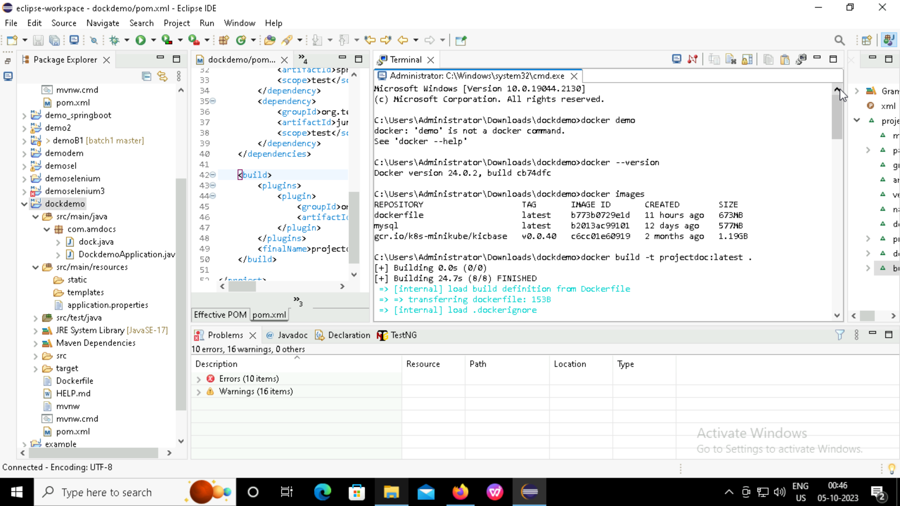
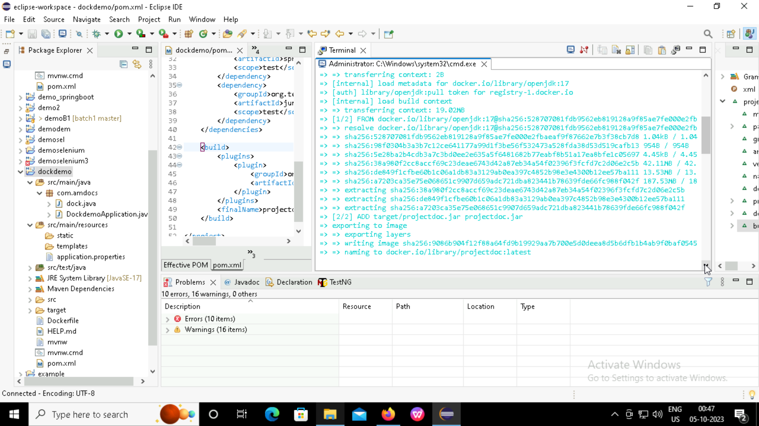
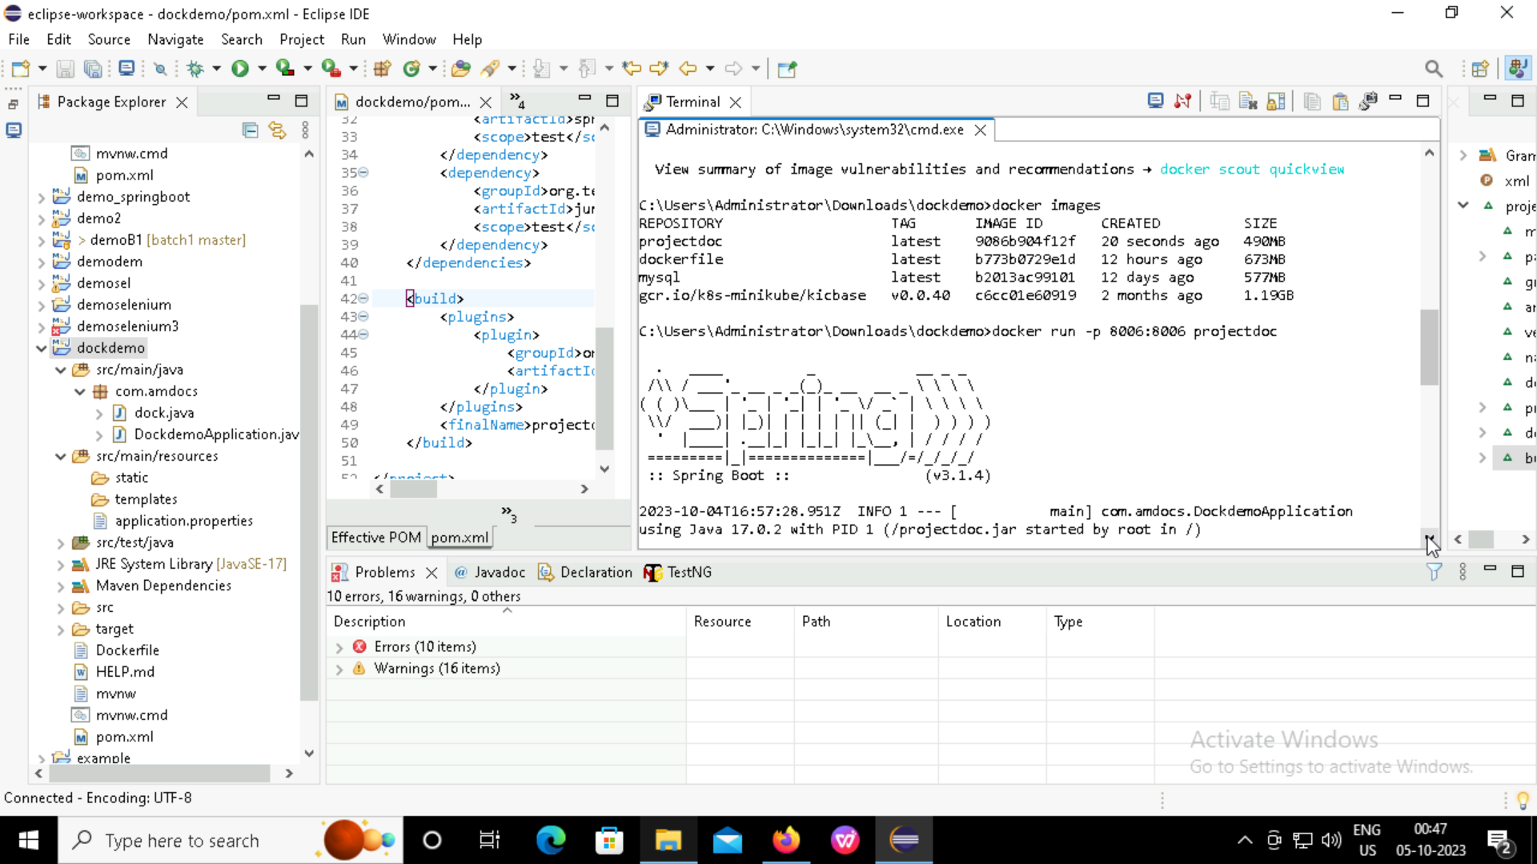
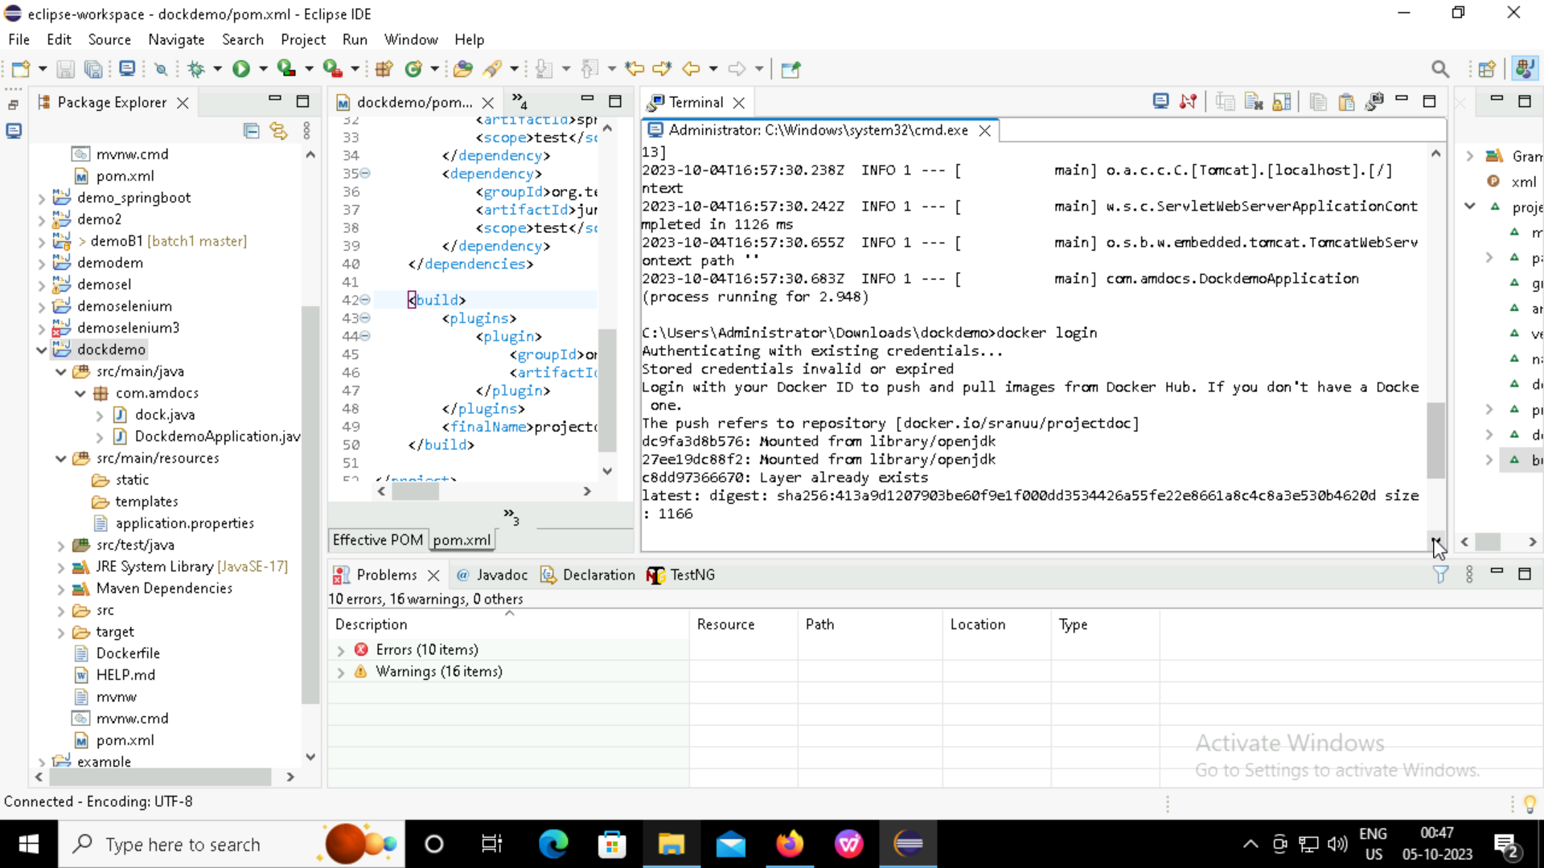
Writing commands and running in docker.

Slide 14
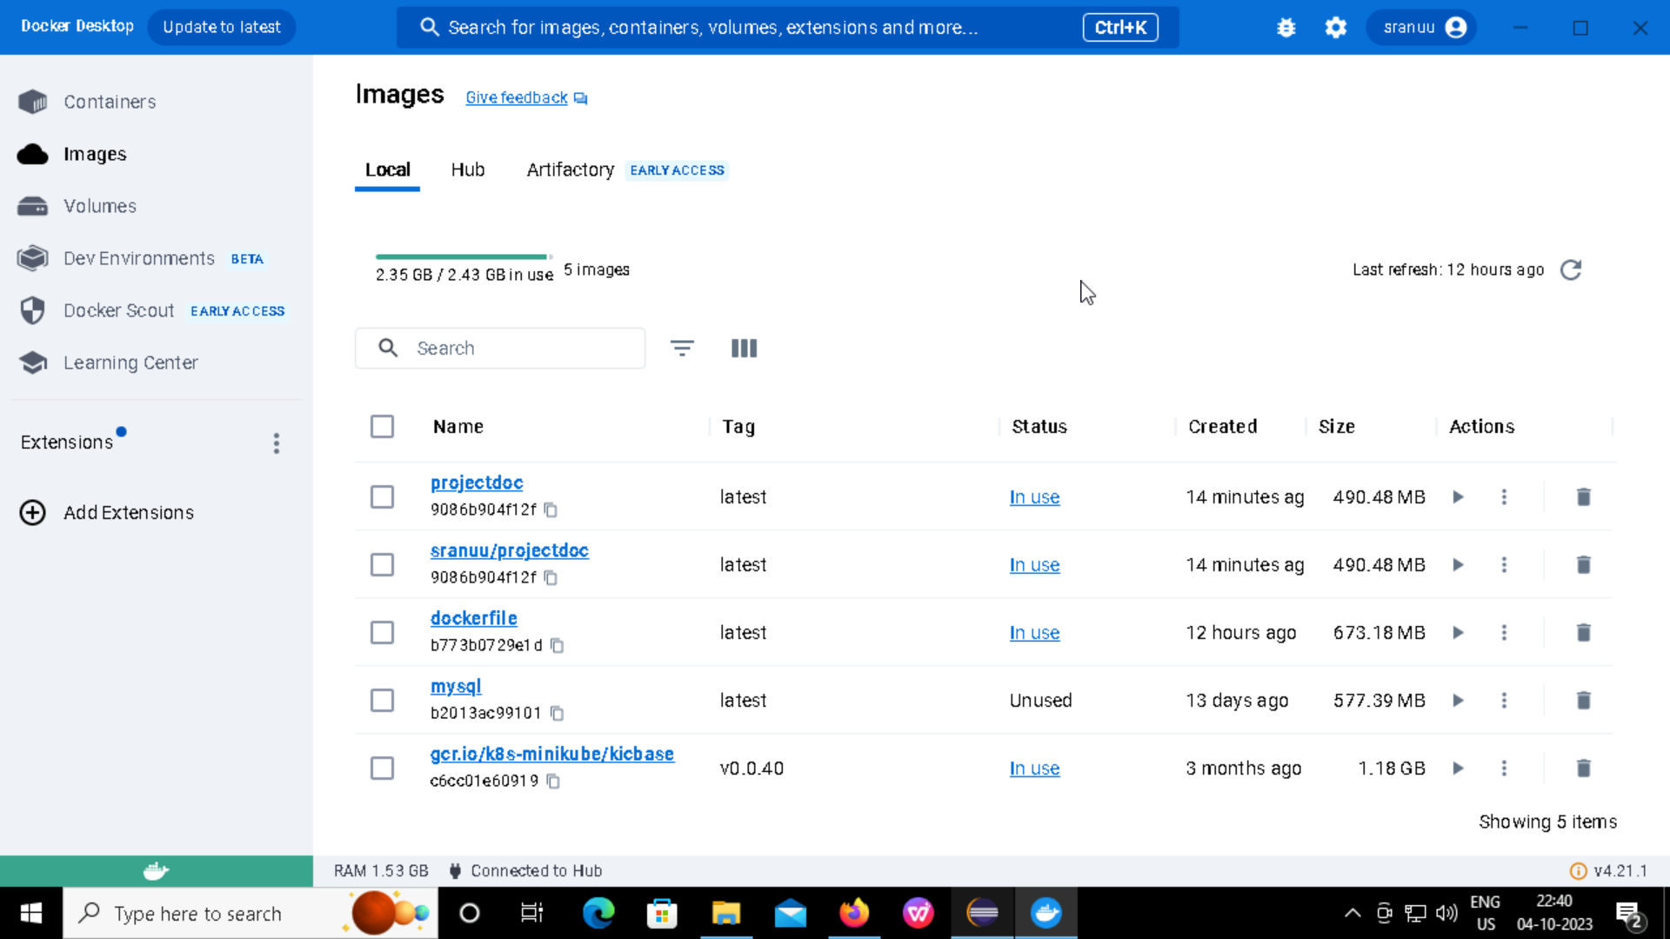
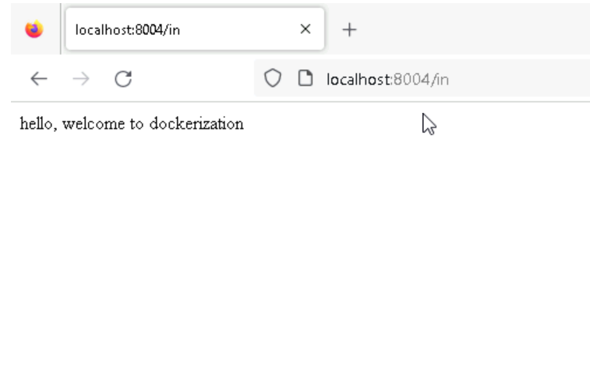
OUTPUT after pushing into docker:

Slide 15
THANK YOU

